Slide 1
Laplacian eigenmap (embedding)
Laplacian L is symmetric and positive semi-definite.
For a connected graph, all its eigenvalues are positive except the smallest one.

Slide 2
Laplacian eigenmap (embedding)

Slide 3
Resistance distance (effective resistance)

Slide 4
Resistance distance (effective resistance)
Consider , a unit current vector flowing from u to v.
Since ,
we can solve V in equation I = LV in terms of :
The voltage difference between u and v is

Slide 5
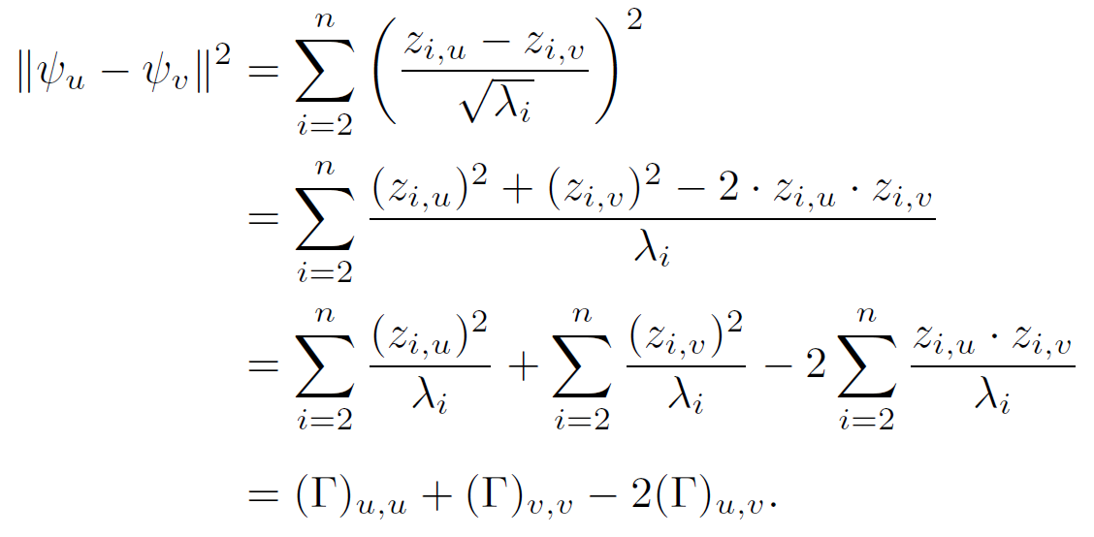
Resistance distance (effective resistance)
Moreover, by direct calculation, we have:

